Slide 1
Chapter 2
Database System Concepts and Architecture

Slide 2
Data Models
One Fundamental characteristics of database approach is that it provides some level of data abstraction by hiding details of data storage for many users
Data Model: A collection of concepts that can be used to describe the structure of a database – provides necessary mean to achieve the abstraction and certain constraints that the database should obey.
Slide 2-<number>

Slide 3
Categories of data models
Conceptual (high-level, semantic) data models
Physical (low-level, internal) data models
Implementation (representational) data models:
Slide 2-<number>

Slide 4
Categories of data models
Conceptual (high-level, semantic) data models: Provide concepts that are close to the way many users perceive data. (Also called entity-based or object-based data models.)
Conceptual data models use concepts such as Entities, attributes and relationship
Physical (low-level, internal) data models: Provide concepts that describe details of how data is stored in the computer.
Slide 2-<number>

Slide 5
Implementation (representational) data models: Provide concepts that fall between the above two, balancing user views with some computer storage details.
RDM may be understood by many users, but still hide some details of data storage
Slide 2-<number>

Slide 6
Schemas versus Instances
Database Schema: The description of a database. Includes descriptions of the database structure and the constraints that should hold on the database.
Schema diagram specified during database design
is not expected to change frequently.
Schema Diagram: A diagrammatic display of (some aspects of) a database schema.
Database Instance: The actual data stored in a database at a particular moment in time. Also called database state (or occurrence).
Slide 2-<number>

Slide 7
Database Schema Vs. Database State
Database State: Refers to the content of a database at a moment in time.
Initial Database State: Refers to the database when it is loaded
Valid State: A state that satisfies the structure and constraints of the database.
Slide 2-<number>

Slide 8
Three-Schema Architecture
Proposed to support DBMS characteristics of:
  Use of catalog to store the database description
  Insulation between program & data, Program-data independence.
  Support of multiple views of the data.
Slide 2-<number>

Slide 9
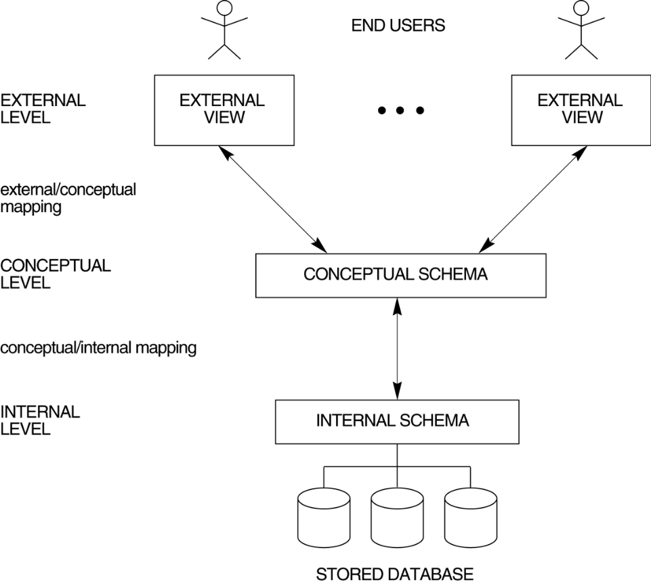
Three Schema Architecture
Slide 2-<number>

Slide 10
Three-Schema Architecture
Defines DBMS schemas at three levels:
  Internal schema at the internal level to describe physical storage structures and access paths. Typically uses a physical data model.
  Conceptual schema at the conceptual level to describe the structure and constraints for the whole database for a community of users. Uses a conceptual or an implementation data model.
  External schemas at the external level to describe the various user views. Usually uses the same data model as the conceptual level.
Slide 2-<number>

Slide 11
Three-Schema Architecture
Mappings among schema levels are needed to transform requests and data. Programs refer to an external schema, and are mapped by the DBMS to the internal schema for execution.
Slide 2-<number>

Slide 12
Data Independence
Defined as capacity to change the schema at one level of database system without having to change the scheme at the next higher level.
Two types of data independence are
    Logical data independence
    Physical data independence
Slide 2-<number>

Slide 13
Data Independence
Logical Data Independence: The capacity to change the conceptual schema without having to change the external schemas and their application programs.
Physical Data Independence: The capacity to change the internal schema without having to change the conceptual schema.
Slide 2-<number>

Slide 14
Data Independence
When a schema at a lower level is changed, only the mappings between this schema and higher-level schemas need to be changed in a DBMS that fully supports data independence. The higher-level schemas themselves are unchanged. Hence, the application programs need not be changed since they refer to the external schemas.
Slide 2-<number>

Slide 15
DBMS Languages
Data Definition Language (DDL): Used by the DBA and database designers to specify the conceptual schema of a database. In many DBMSs, the DDL is also used to define internal and external schemas (views). In some DBMSs, separate storage definition language (SDL) and view definition language (VDL) are used to define internal and external schemas.
Slide 2-<number>

Slide 16
DBMS Languages
Data Manipulation Language (DML): Used to specify database retrievals and updates.
  DML commands (data sublanguage) can be embedded in a general-purpose programming language (host language), such as COBOL, C or an Assembly Language.
  Alternatively, stand-alone DML commands can be applied directly (query language).
Slide 2-<number>

Slide 17
DBMS Languages
High Level or Non-procedural Languages: e.g., SQL, are set-oriented and specify what data to retrieve than how to retrieve. Also called declarative languages.
Low Level or Procedural Languages: record-at-a-time; they specify how to retrieve data and include constructs such as looping.
Slide 2-<number>

Slide 18
DBMS Interfaces
Stand-alone query language interfaces.
Programmer interfaces for embedding DML in programming languages:
  Pre-compiler Approach
  Procedure (Subroutine) Call Approach
User-friendly interfaces:
  Menu-based, popular for browsing on the web
  Forms-based, designed for naïve users
  Graphics-based (Point and Click, Drag and Drop etc.)
  Natural language: requests in written English
  Combinations of the above
Slide 2-<number>

Slide 19
Other DBMS Interfaces
  Speech as Input (?) and Output
  Web Browser as an interface
  Parametric interfaces (e.g., bank tellers) using function keys.
  Interfaces for the DBA:
    Creating accounts, granting authorizations
    Setting system parameters
    Changing schemas or access path
Slide 2-<number>

Slide 20
Database System Utilities
To perform certain functions such as:
  Loading data stored in files into a database. Includes data conversion tools.
  Backing up the database periodically on tape.
  Reorganizing database file structures.
  Report generation utilities.
  Performance monitoring utilities.
  Other functions, such as sorting, user monitoring, data compression, etc.
Slide 2-<number>

Slide 21
Other Tools
Data dictionary / repository:
    Used to store schema descriptions and other information such as design decisions, application program descriptions, user information, usage standards, etc.
    Active data dictionary is accessed by DBMS software and users/DBA.
    Passive data dictionary is accessed by users/DBA only.
  Application Development Environments and CASE (computer-aided software engineering) tools:
    Examples – Power builder (Sybase), Builder (Borland)
Slide 2-<number>

Slide 22
Centralized and Client-Server Architectures
Centralized DBMS: combines everything into single system including- DBMS software, hardware, application programs and user interface processing software.
Slide 2-<number>

Slide 23
Basic Client-Server Architectures
Specialized Servers with Specialized functions
Clients
DBMS Server
Slide 2-<number>

Slide 24
Specialized Servers with Specialized functions:
File Servers
Printer Servers
Web Servers
E-mail Servers
Slide 2-<number>

Slide 25
Clients:
Provide appropriate interfaces and a client-version of the system to access and utilize the server resources.
Clients maybe diskless machines or PCs or Workstations with disks with only the client software installed.
Connected to the servers via some form of a network.
(LAN: local area network, wireless network, etc.)
Slide 2-<number>

Slide 26
DBMS Server
Provides database query and transaction services to the clients
Sometimes called query and transaction servers
Slide 2-<number>

Slide 27
Two Tier Client-Server Architecture
User Interface Programs and Application Programs run on the client side
Interface called ODBC (Open Database Connectivity – see Ch 9) provides an Application program interface (API) allow client side programs to call the DBMS. Most DBMS vendors provide ODBC drivers.
Slide 2-<number>

Slide 28
Two Tier Client-Server Architecture
A client program may connect to several DBMSs.
Other variations of clients are possible: e.g., in some DBMSs, more functionality is transferred to clients including data dictionary functions, optimization and recovery across multiple servers, etc. In such situations the server may be called the Data Server.
Slide 2-<number>

Slide 29
Three Tier Client-Server Architecture
Common for Web applications
Intermediate Layer called Application Server or Web Server:
  stores the web connectivity software and the rules and business logic (constraints) part of the application used to access the right amount of data from the database server
  acts like a conduit for sending partially processed data between the database server and the client.
Additional Features- Security:
  encrypt the data at the server before transmission
  decrypt data at the client
Slide 2-<number>

Slide 30
Classification of DBMSs
Based on the data model used:
  Traditional: Relational, Network, Hierarchical.
  Emerging: Object-oriented, Object-relational.
Other classifications:
  Single-user (typically used with micro- computers) vs. multi-user (most DBMSs).
  Centralized (uses a single computer with one database) vs. distributed (uses multiple computers, multiple databases)
Slide 2-<number>

Slide 31
Classification of DBMSs
Distributed Database Systems have now come to be known as client server based database systems because they do not support a totally distributed environment, but rather a set of database servers supporting a set of clients.
Slide 2-<number>

Slide 32
Variations of Distributed Environments:
Homogeneous DDBMS
Heterogeneous DDBMS
Federated or Multidatabase Systems
Slide 2-<number>

